Slide 1
SPEECH EMOTION RECOGNITION

Slide 2
Team Members:
Vignesh Karthik A
Sivaganesh V
Anbuselvam A
Guidance:
Dr. S. palanisamy

Slide 3
ABSTRACT
The speech emotion recognition is a very interesting yet very challenging task of human computer interaction. In the recent years this topic has grabbed so much attention. In the field of speech emotion recognition many techniques have been utilized to extract emotions from signals, including many well-established speech analysis and classification techniques. In the traditional way of speech emotion recognition features are extracted from the speech signals and then the features are selected which is collectively known as selection module and then the emotions are recognized. This is a very lengthy and time taking process, so in this project we proposed a system based on deep learning techniques for feature extraction and model creation which is used to recognized emotions conveyed by speech.

Slide 4
PROBLEM STATEMENT
To create a speech emotion recognition system using machine learning that can accurately predict emotions conveyed through speech.
The model should be trained with a large dataset to be abled to predict different vocal ranges.
The model should be able to classify range of emotions such as happiness , sadness , anger , nuetral and pleasant surprise

Slide 5
EXISTING SYSTEM
In existing speech recognition system , an emotion is recognized using feature selection. The fundamental components are signal processing , feature extraction, feature selection and feature classification.
SIGNAL PROCESSING : In the first stage the voice signal is enhanced and noise is removed.
FEATURE EXTRACTION : The voice signal is split into various features pitch and frequency.
FEATURE SELECTION : Based on above features the voices are selected to represent different emotions.
FEATURE CLASSIFICATION : The selected voices are then grouped into similar patterned voice features that can be used to classify emotions.

Slide 6
PROPOSED SOLUTION
The proposed solution for speech emotion recognition will follow the following steps:
DATA COLLECTION & PREPROCESSING: Collect a dataset of speech recordings with corresponding emotions. Pre-process the data to extract vocal features.
FEATURE EXTRACTION: Use CNN to extract features from the pre-processed speech data.
SEQUENCE MODELING: Use LSTM to model the sequential nature of speech data.
EMOTION CLASSIFICATION: The output of the LSTM network will be fed into a fully connected layer that maps the features to the different emotions.
TESTING EVOLUTION: The performance of the model will be evaluated on a separate test set of labelled speech recordings.

Slide 7
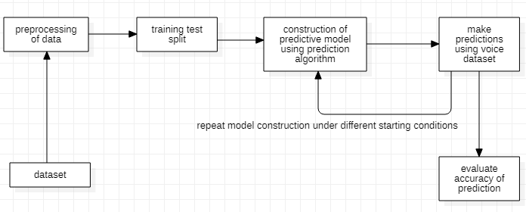
SYSTEM ARCHITECTURE

Slide 8
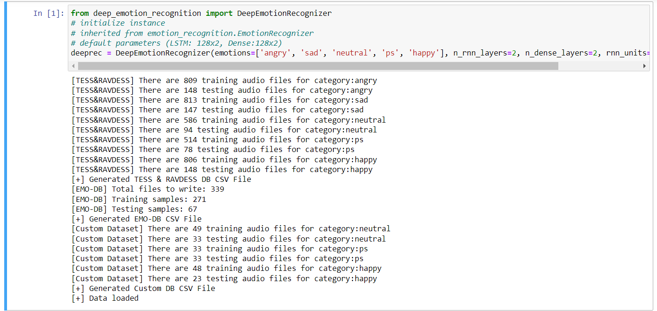
SYSTEM IMPLEMENTATION
PREPARING THE DATASET: For the dataset, we use open-source libraries such as RAVDESS, TESS and EMO-DB. All of these datasets provide a large pool of information that is used to train the system.
LOADING THE DATASET: This process is about loading the dataset in Python which involves extracting audio features, such as obtaining different features such as power, pitch, and vocal tract configuration from the speech signal, librosa library is used to do that.

Slide 9
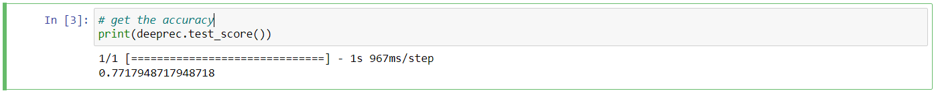
TRAINING THE MODEL:After we prepare and load the dataset, we simply train it on a suited sklearn model.
TESTING THE MODEL: The final accuracy of the model is calculated.

Slide 10
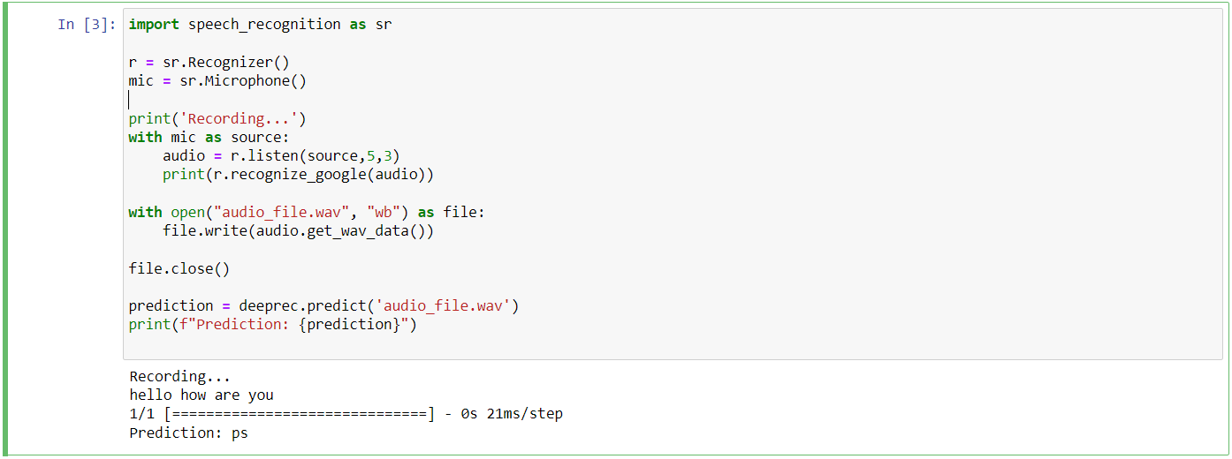
PREDICT CUSTOM INPUTS: This program helps the user to use his own voice and let the system predict the emotions shown by the user.

Slide 11
SYSTEM APPLICATION
A Speech emotion recognition system can be implemented in many fields that require voice-based interface such as a personnel assistant, live transcript of speech, etc.
speech emotion recognition can be used to find the emotional range or sentimental value in various audio recordings such as job interviews, caller-agent calls, streaming videos, and songs.
It can be used for music recommendation or classification systems can cluster songs based on their mood and recommend curated playlists to the user.

Slide 12
CONCLUSION
In this project, we proposed a solution for speech emotion recognition using deep learning models such as LSTM and CNN. This solution highlighted the processing and feature extraction techniques in improving the accuracy of the models.
overall, the result of this project indicate that the deep learning models can be effective in recognizing emotions from speech as it provided an average of approximately 76% accuracy over repeated testing.

Slide 13
THANK YOU

